Slide 1
Permission with: may, can, could, would/do you mind if…
Basic 12 unit 10a

Slide 2
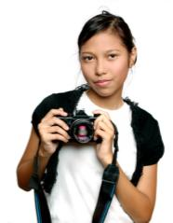

7-5 POLITE QUESTIONS: MAY I, COULD I, CAN I
Asking for permission
(a) May I take your picture?
(b) Could I take your picture?
(c) Can I take your picture?
POSSIBLE ANSWERS
Of course.
Okay.
Yes.
Sure.
Certainly.
Yes. Of course.
Sorry, not today.
Yes. Certainly.
Uh-huh.

Slide 3
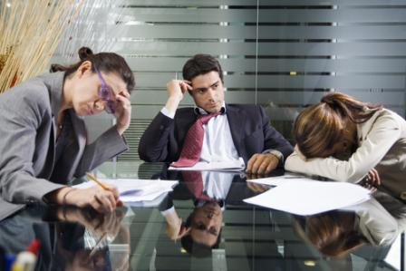
Do you mind if I go home now?
7-7 EXPRESSING ADVICE: SHOULD AND OUGHT TO
No, go ahead. I am going home, too.

Slide 4
Would you mind if I went home now?
Thank you. See you tomorrow.
7-7 EXPRESSING ADVICE: SHOULD AND OUGHT TO
No, go ahead. I am going home, too.

Slide 5
Would you mind if I went home now?
Ok, ☹
Let´s continue the analysis.
7-7 EXPRESSING ADVICE: SHOULD AND OUGHT TO
Sorry, but we have to continue and finish this.

Slide 6
Permission
Would you mind if …..?
= Is it a problem for you if..
Do you mind if…..?
May I…
Can I… = Is it possible for me to…
Could I…

Slide 7
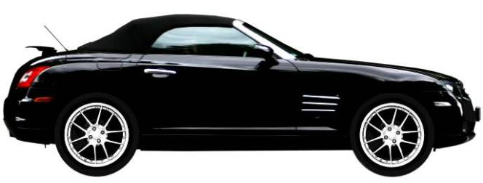
7-5 LET’S PRACTICE
CORRECT
?
YES
NO
Can I borrow your car?

Slide 8
7-5 LET’S PRACTICE
CORRECT
?
YES
NO
Do you mind if I borrow your car?

Slide 9
7-5 LET’S PRACTICE
CORRECT
?
YES
NO
Could I borrowed your car?

Slide 10
7-5 LET’S PRACTICE
CORRECT
?
YES
NO
Would you mind if I borrowed your car?

Slide 11
7-5 LET’S PRACTICE
CORRECT
?
YES
NO
Do you mind if I borrowed your car?

Slide 12
Time to practice

Slide 13
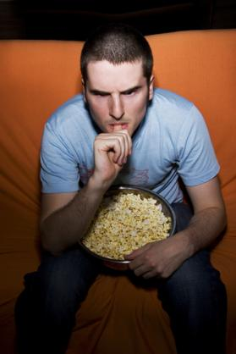
I´m hungry. My friend has an extra chocolate.
I have a party. I´m going to ask my mother for permission
It´s hot and the window is closed. Ask your friend to open it.
Tomorrow is the exam, and you don´t understand anything. Ask your friend to tutor you.
7-8 LET’S PRACTICE
✓
✓
✓

